Slide 1
ASE Project KCEASY CARS
Devi Prasad Kada (Class id:18)
Santosh Gandhi Diddi(Class id:12)
Mourya Praharsha Bobbili (Class id:8)
Vinay Chandra Vasamsetti (Class id:42)

Slide 2
Objective:
The key objective of the application is to provide quick and easy access of cars to the people migrating and travelling places.
The main motto is to create an interactive web based application which provides details of rental cars and used cars dealers available in that area and also provide necessary steps required for their car registration process.
If the car is met with any accident then our web application also provide steps for the reporting and handling claims, minor and major mechanical repairs.

Slide 3
Significance:
Our application allows users to
Register and post their car.
Register and buy a car.
Chat between the seller and buyers.
Guidelines for car Management.

Slide 4
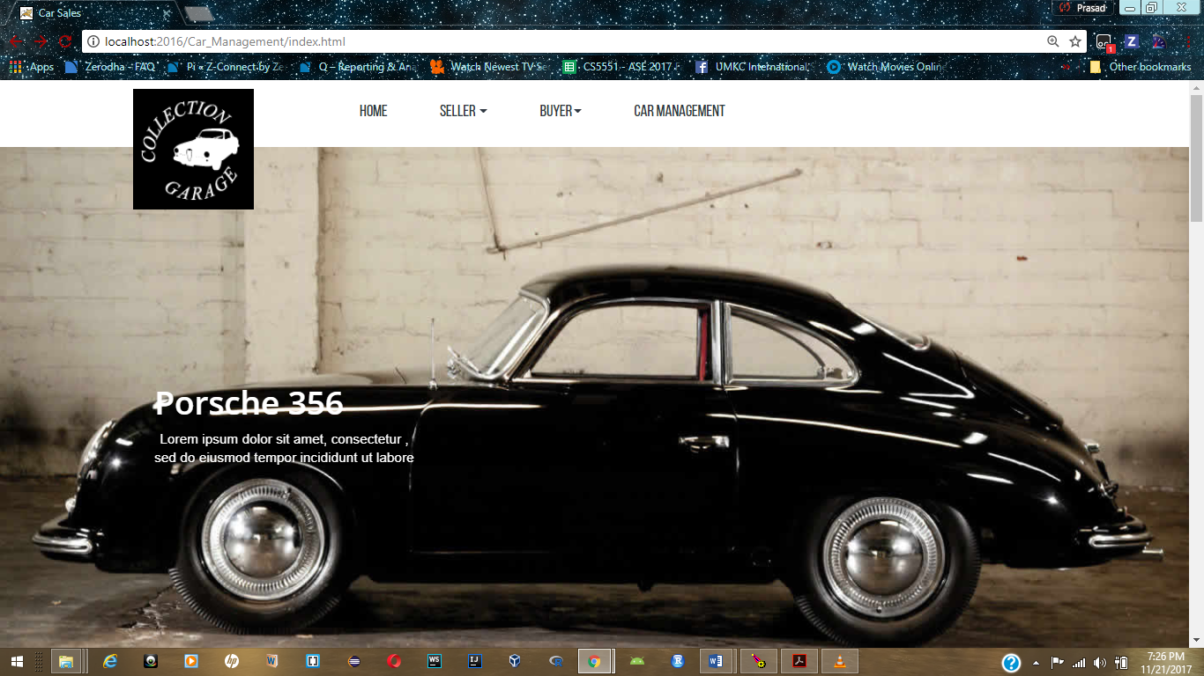
Home Page:

Slide 5
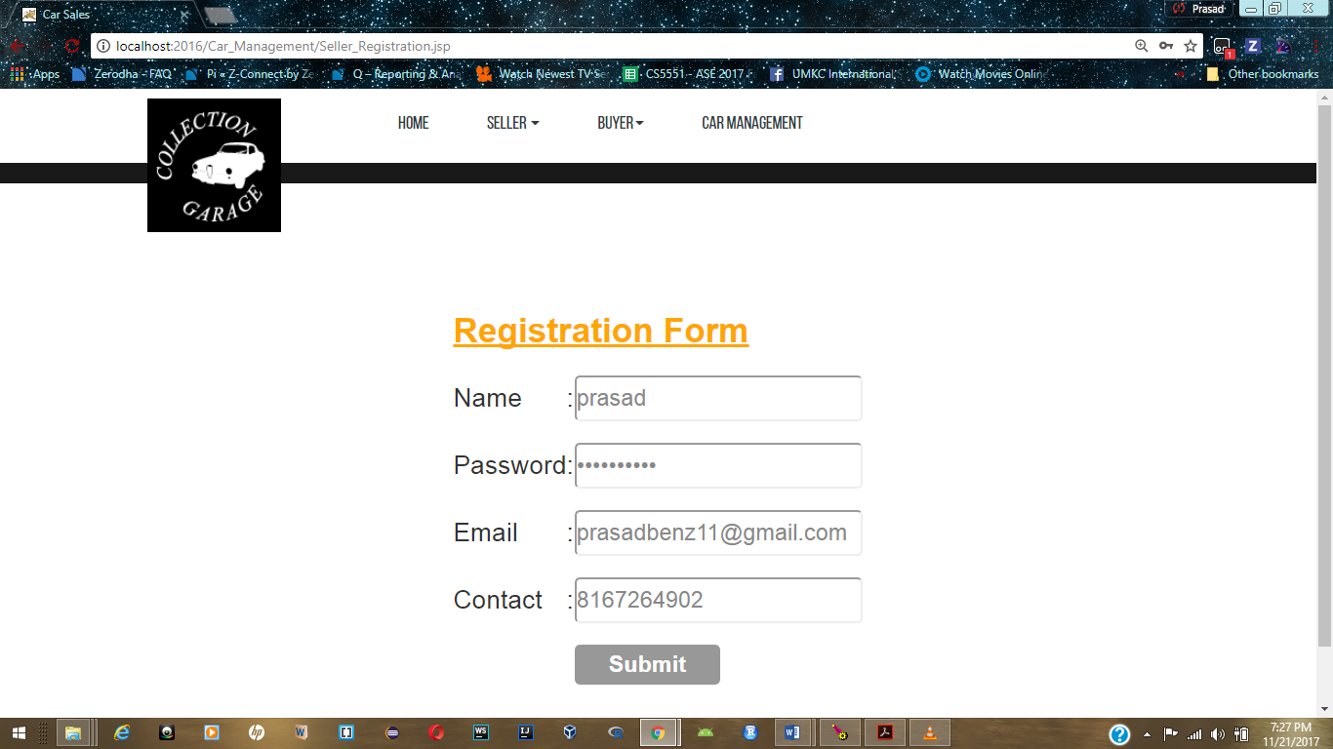
User Registration :

Slide 6
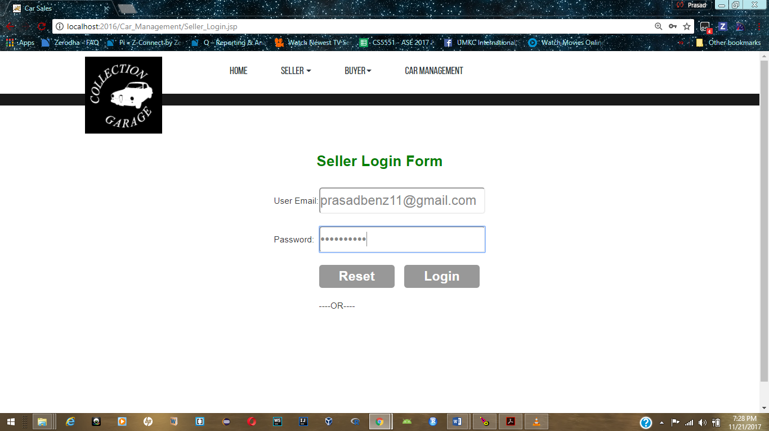
Login Page:

Slide 7
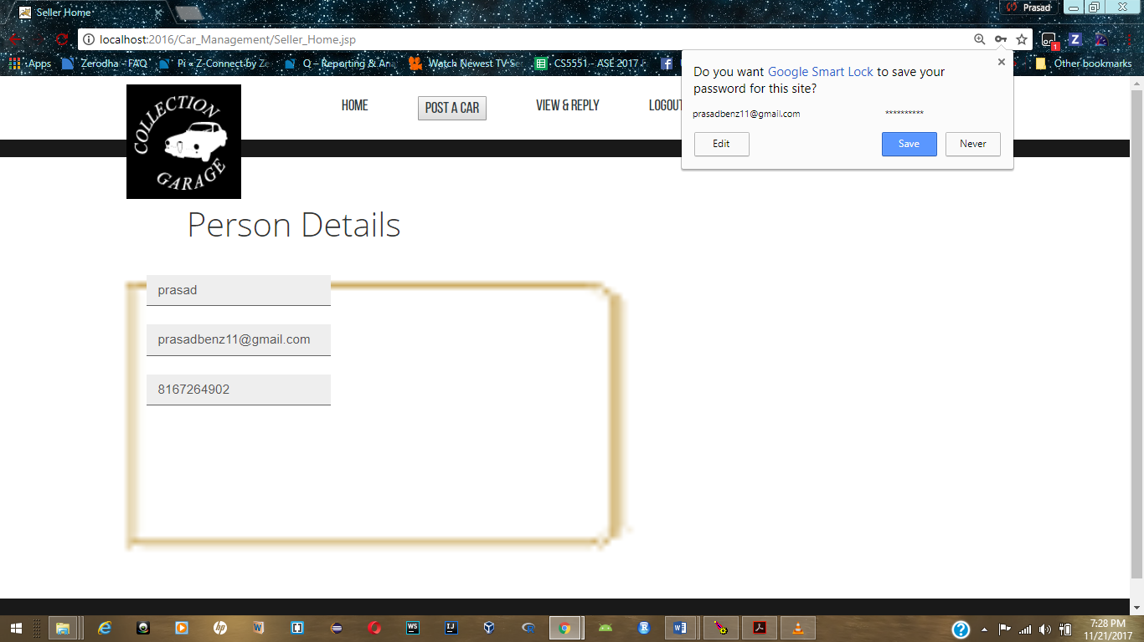
Home Page of Logged in User:

Slide 8
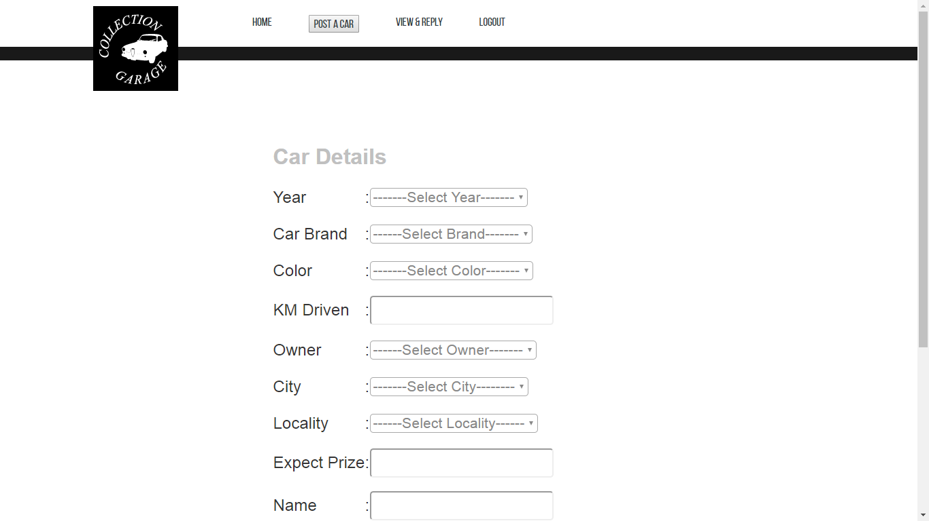
Seller Posting a Car:

Slide 9
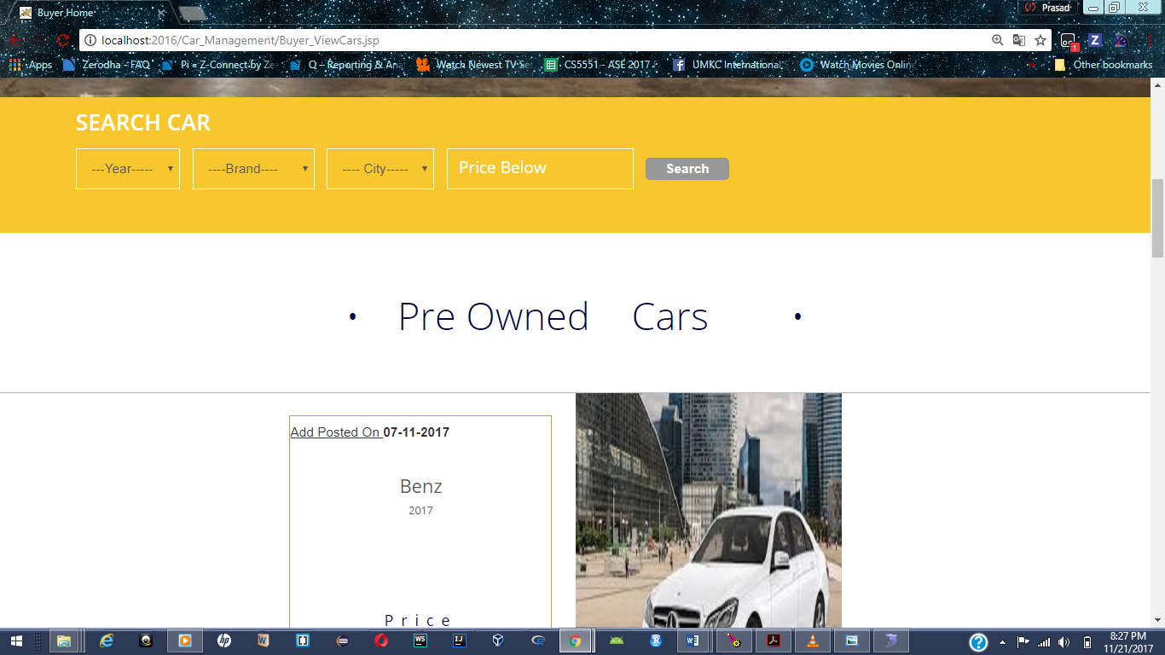
Buyer Views Cars(with filters):

Slide 10
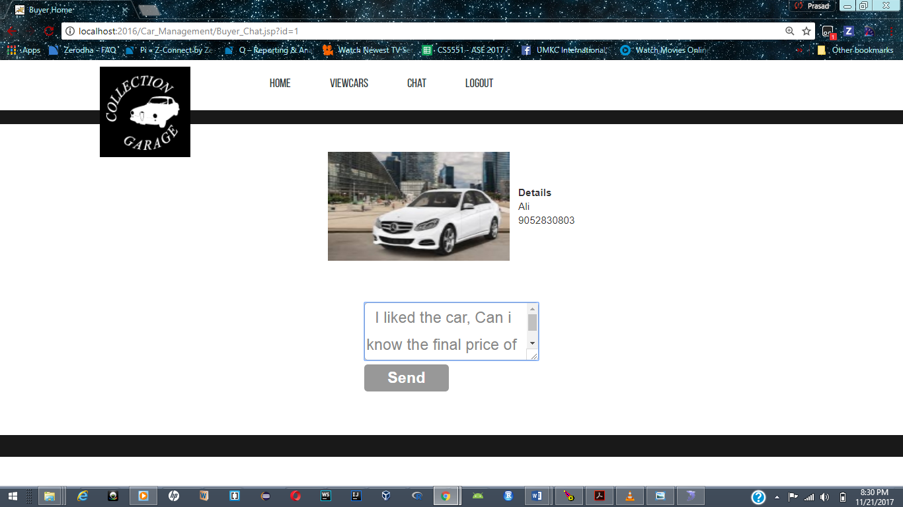
Chat between Seller and Buyer:

Slide 11
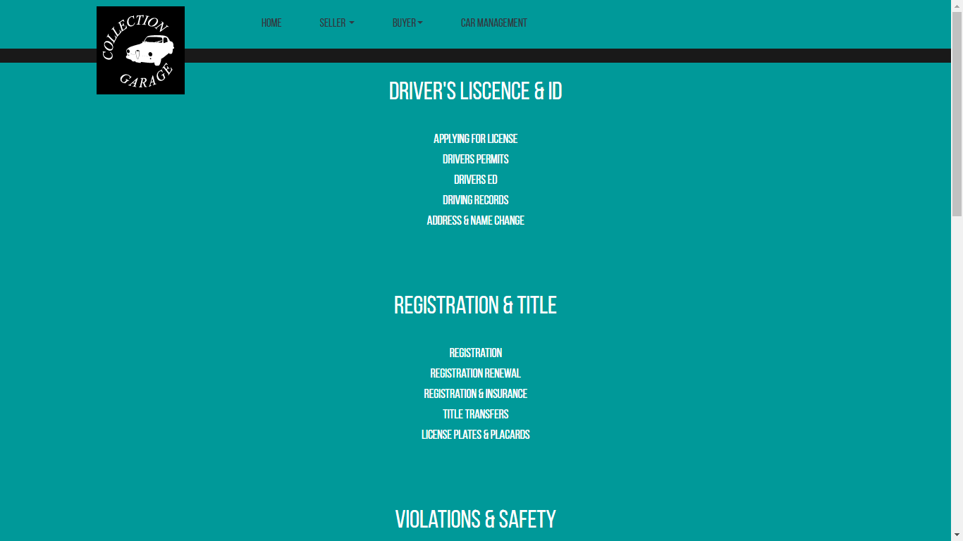
Car Management:

Slide 12


